Slide 1
Image De-noising with Kernel Principal Component Analysis implementing the Morlet Wavelet Kernel
Final Presentation
Presented By, Kernal Kings
Biswajit Rana
MSc Big Data Analytics (B2330026)
And
Uddalak Mukherjee
MSc Big Data Analytics (B2330042)

Slide 2
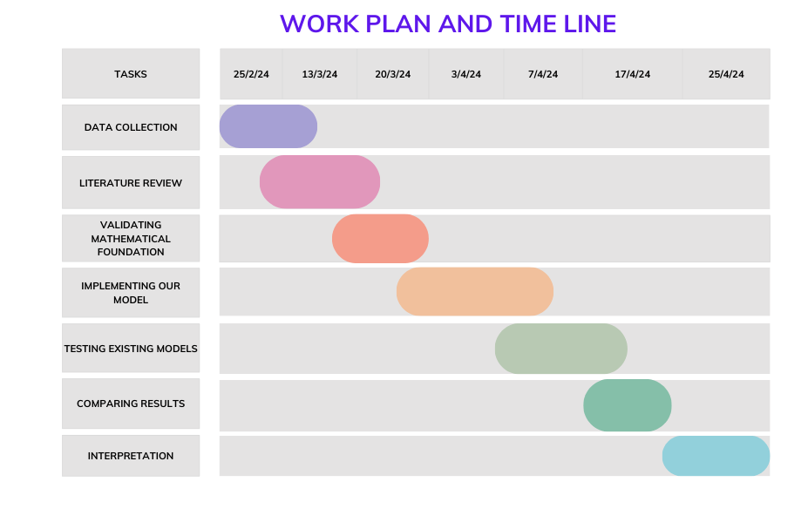
✔️
✔️
✔️
✔️
✔️
✔️
✔️

Slide 3
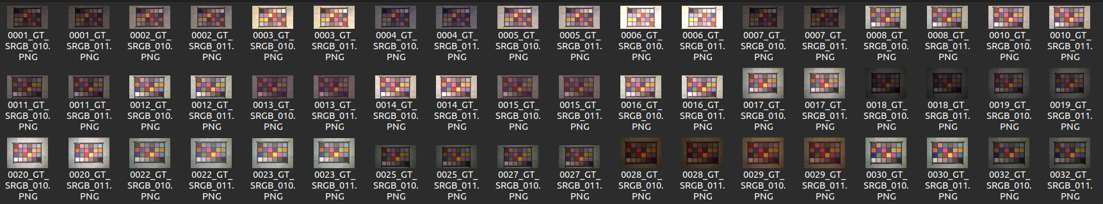
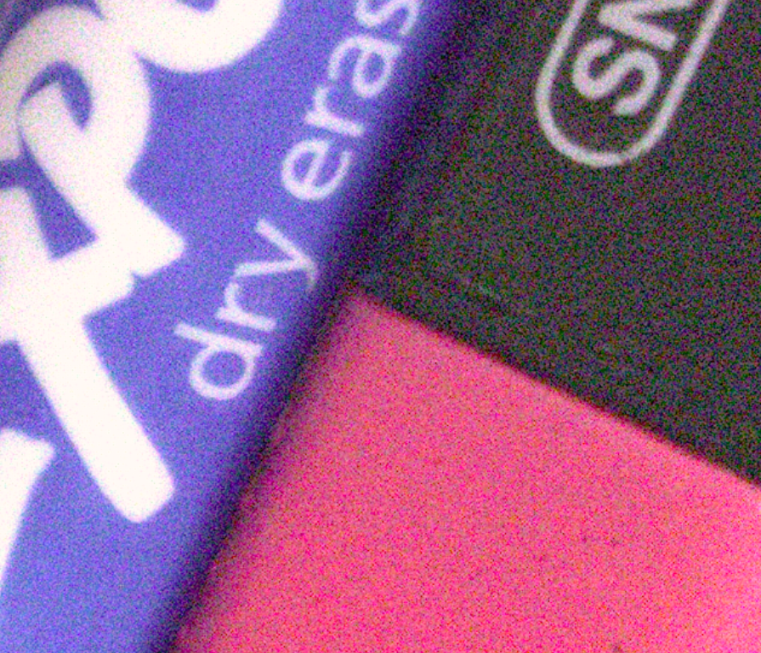
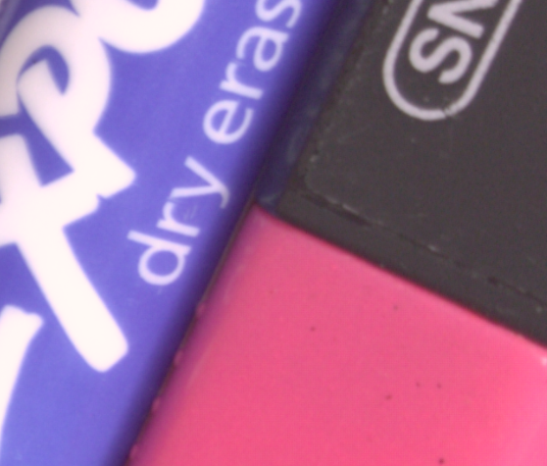
Data Collection:
We have collected the data from https://abdokamel.github.io/sidd/ (Smartphone Image Denoising Dataset)
Data contains 320 pairs of Noisy and True images.
Images are from various scenes with different brightness, Exposure and lighting. Given sample of one scene.
Zoomed Noisy Image
Zoomed True Image

Slide 4
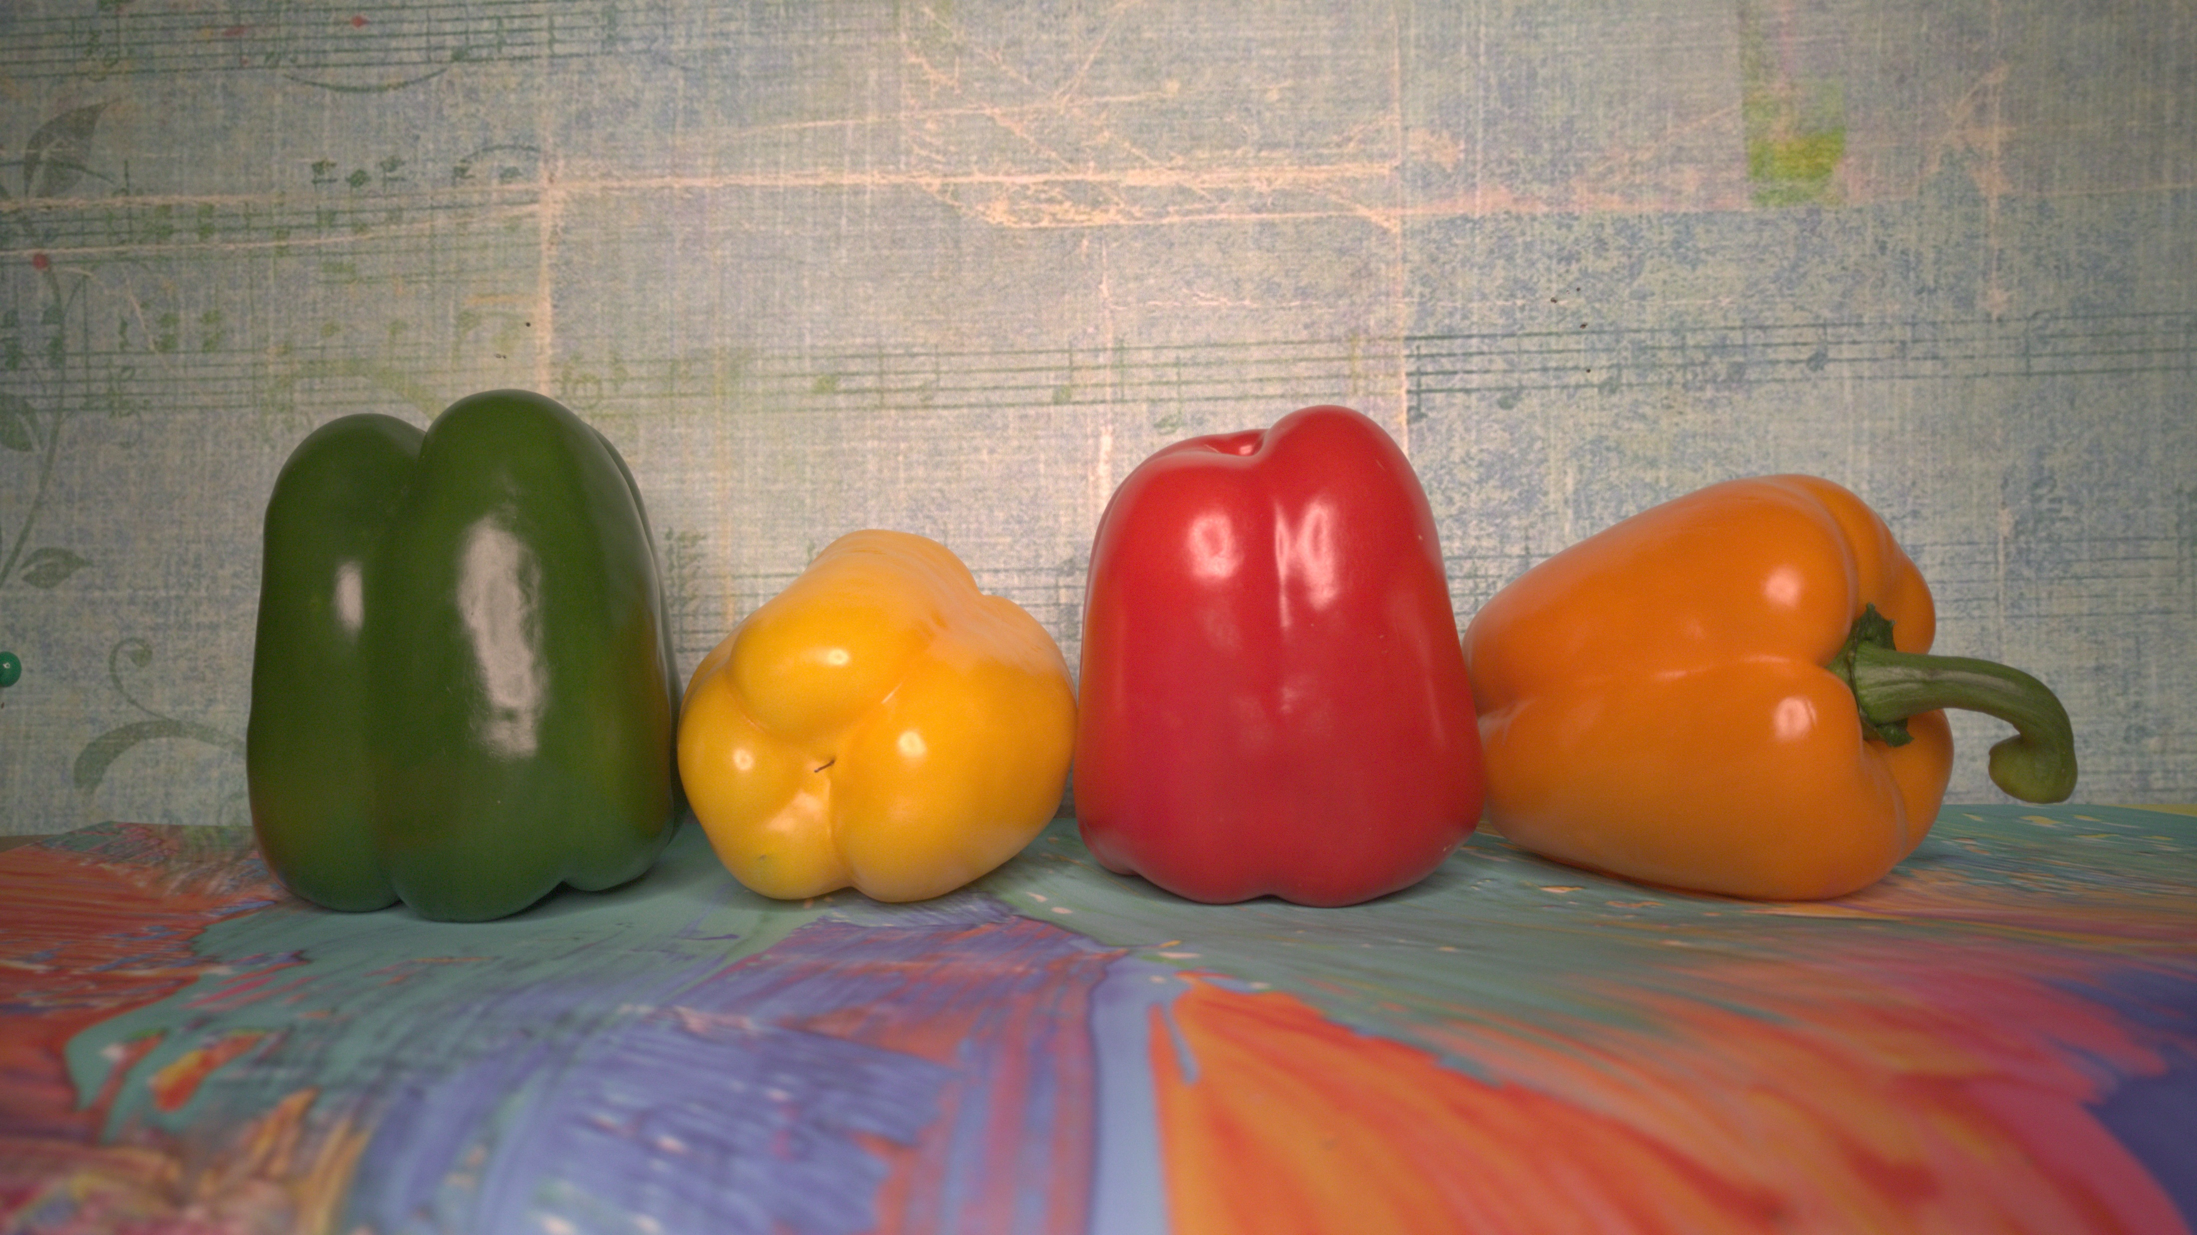
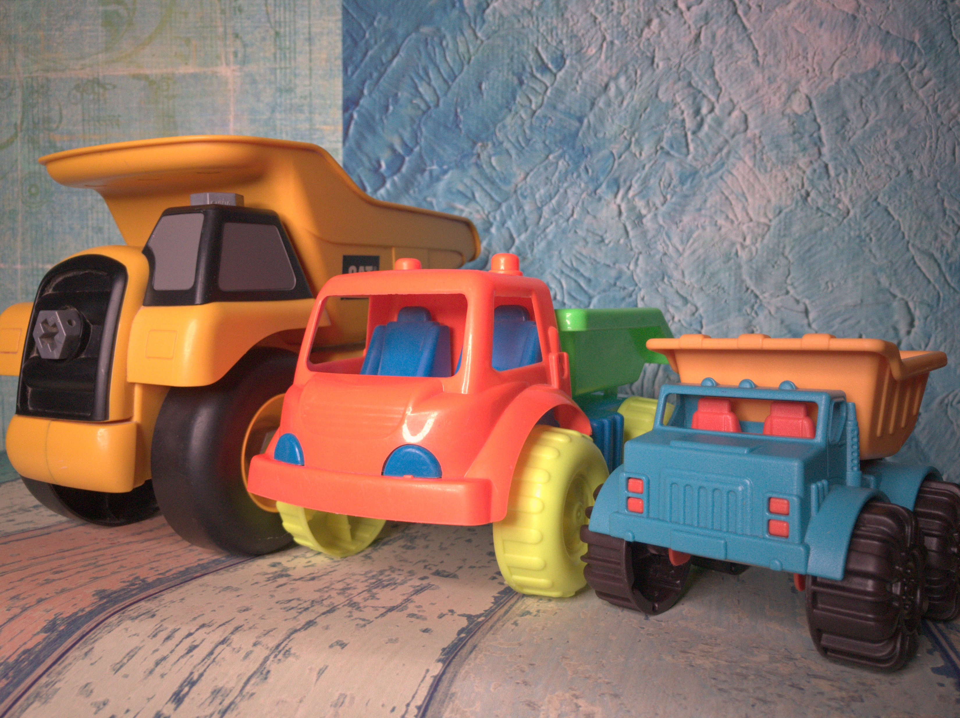
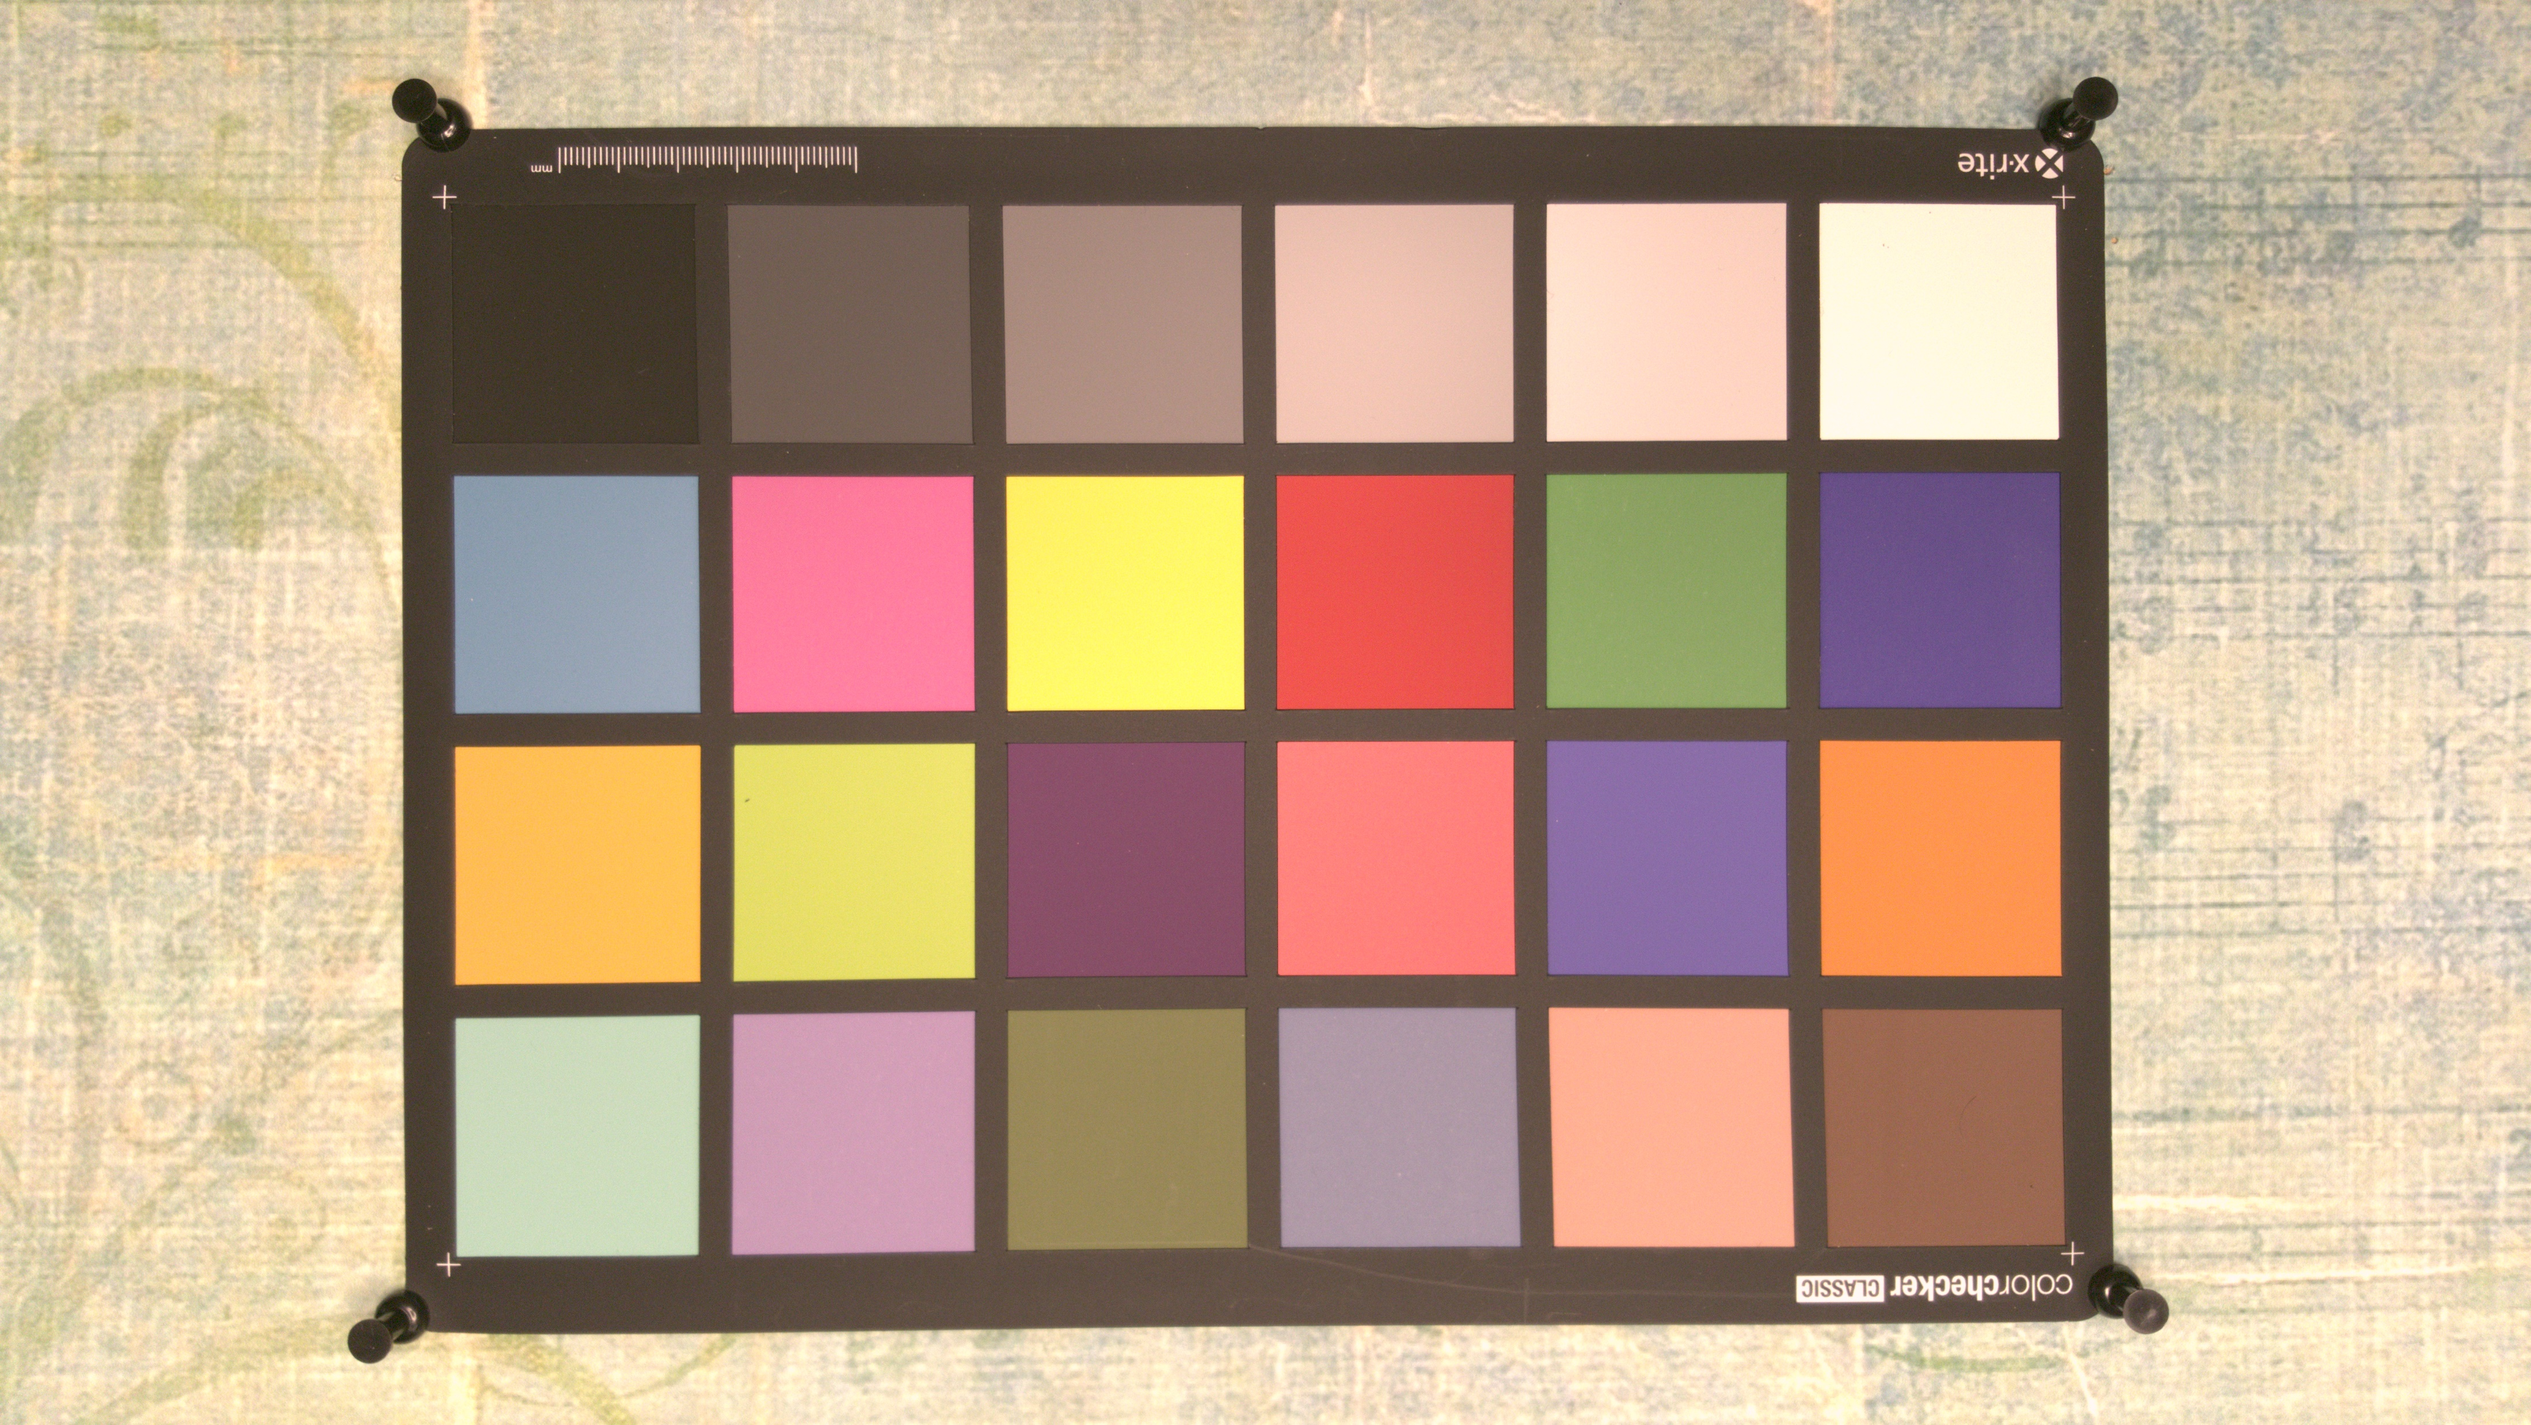
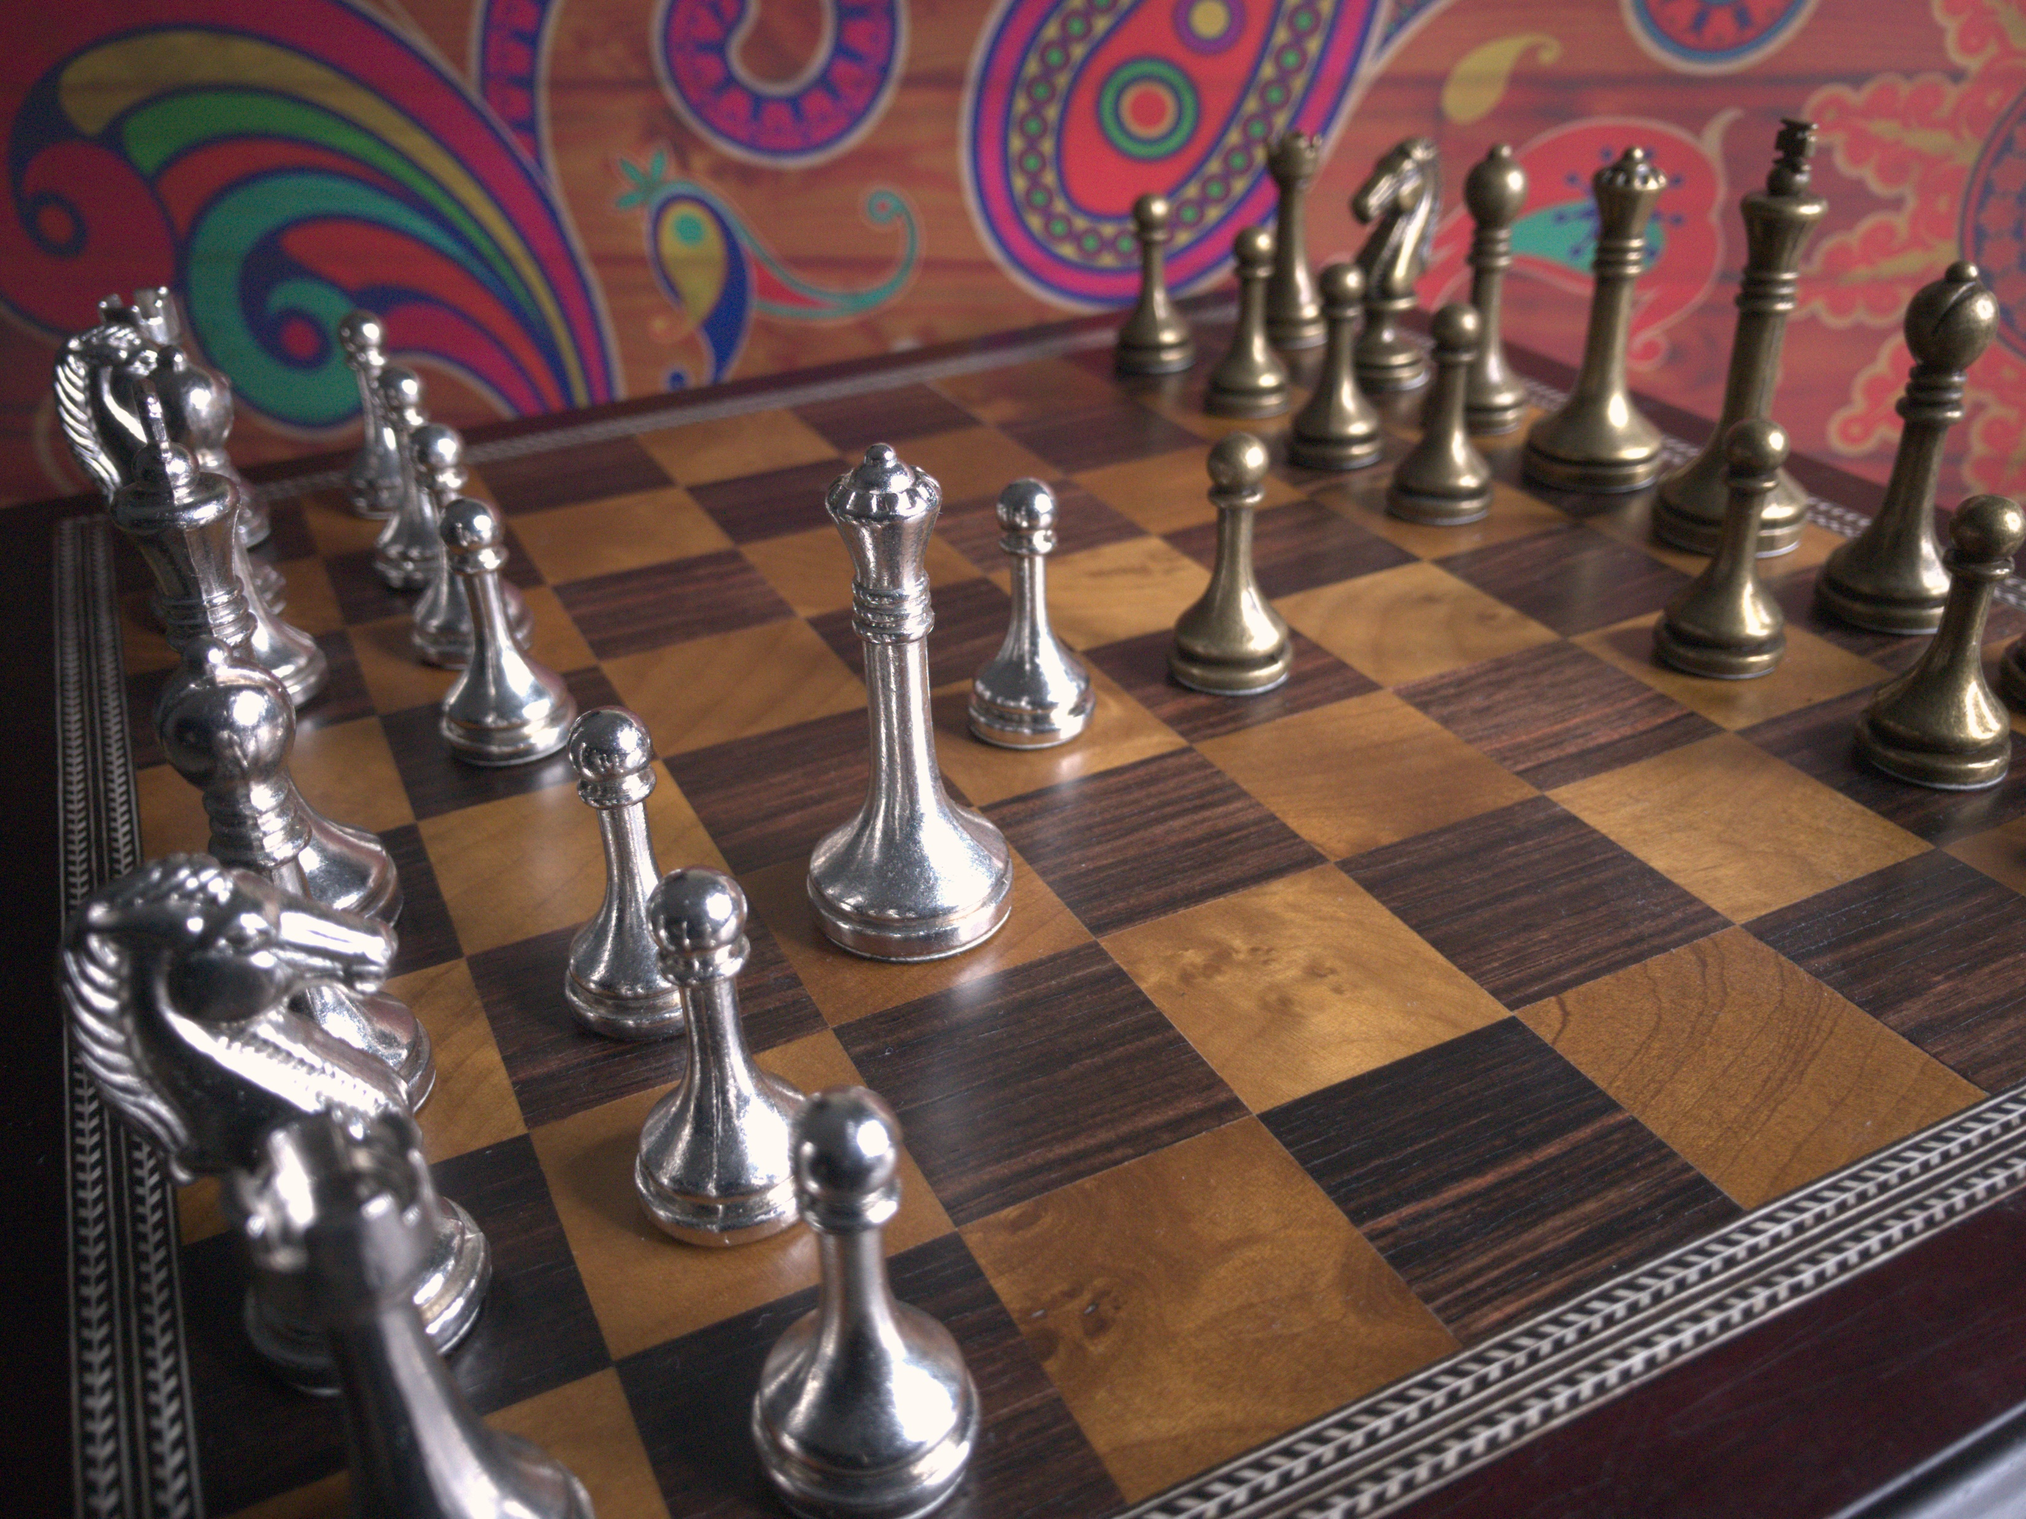
Noisy Images (taken for experiment):

Slide 5

Standard Image (noisy) :

Slide 6
Literature Review :
The following 3 papers are being studied to get further insights on the use of dimensionality reduction in image processing.
[1] S.Krishnan P.Lio S.Xie, A.T.Lawniczak. “Wavelet kernel principal component analysis in noisy multiscale data classification.” ISRN Computational Mathematics, 259:4–6,2012.
[2] P.Li Y.Tang T.You, Y.Hu. “An improved imperialist competitive algorithm for global optimization.” Turkish Journal of Electrical Engineering and Computer Science, pages 5–6, 2019.
[3]Abdelhamed, Abdelrahman, Stephen Lin, and Michael S. Brown. "A HighQuality Denoising Dataset for Smartphone Cameras." Proceedings of the IEEE Conference on Computer Vision and Pattern Recognition. 2018, pp. 1692-1700.

Slide 7
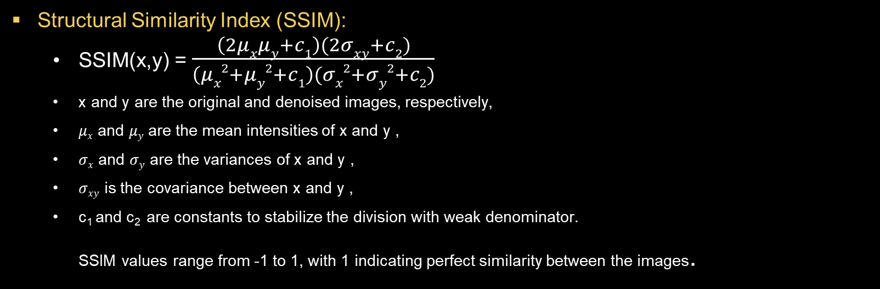
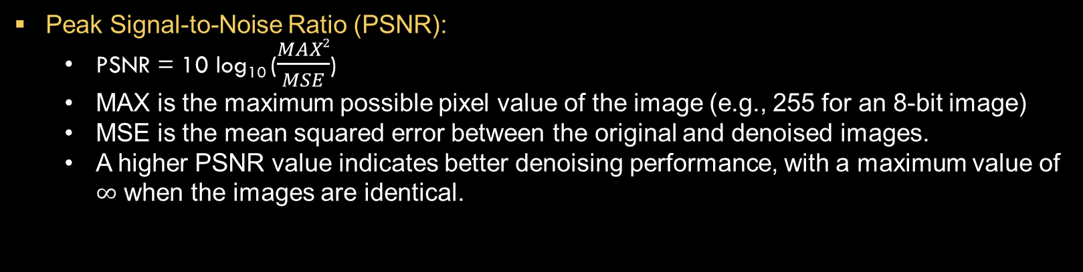
Metrics of Comparison:
Peak Signal-to-Noise Ratio (PSNR):
PSNR = 10 log₁₀ ($\frac{MAX2}{MSE}$)
MAX is the maximum possible pixel value of the image (e.g., 255 for an 8-bit image)
MSE is the mean squared error between the original and denoised images.
A higher PSNR value indicates better denoising performance, with a maximum value of $∞$ when the images are identical.
Structural Similarity Index (SSIM):
SSIM(x,y) = $\frac{\left(2μxμy+c1\right)(2σxy+c2)}{\left(μx2+μy2+c1\right)(σx2+σy2+c2)}$
x and y are the original and denoised images, respectively,
$μx$ and $μy$ are the mean intensities of x and y ,
$σx$ and $σy$ are the variances of x and y ,
$σxy$ is the covariance between x and y ,
c₁ and c₂ are constants to stabilize the division with weak denominator. SSIM values range from -1 to 1, with 1 indicating perfect similarity between the images.

Slide 8
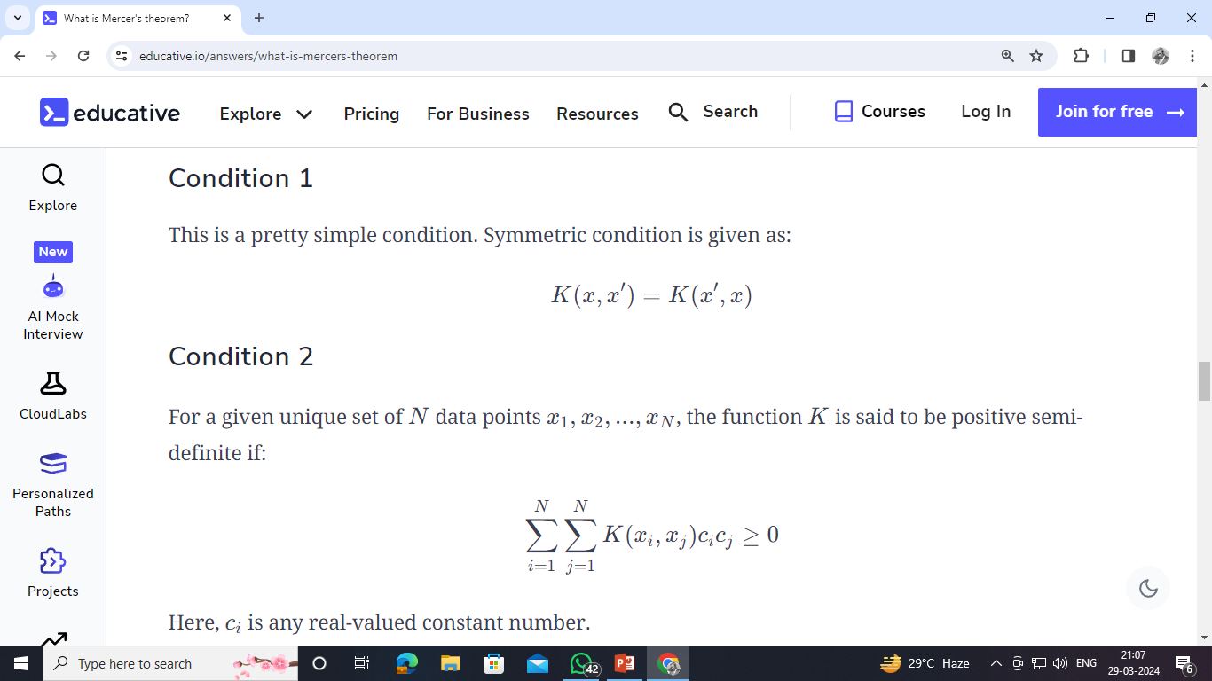
Validating Mathematical Foundation:
In order to use the proposed function as a Kernel, the Mercer condition needed to be verified.
A rigorous proof was penned down to show that the function indeed satisfies the conditions. The fact that is indeed a Kernel was conjectured in [1] and our proof was partly motivated from a proof in [1] which used a similar technique to validate the condition for a different family of wavelet functions.

Slide 9
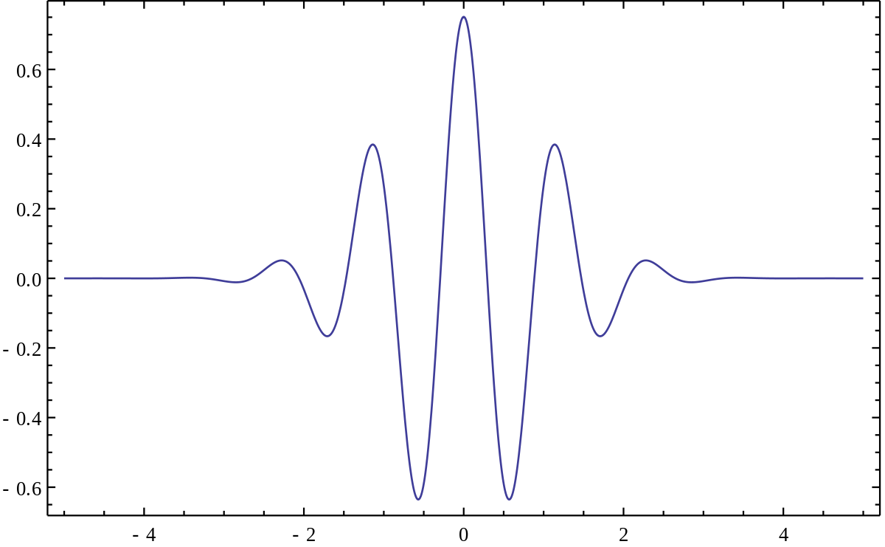




Implementing Our Model :
Now we have tried to denoise the image using Wavelet function based kernel.
We have done the same things with this as we have done in previous case.
We generated the image one by one .
Tried to regenerate the denoised image with color in more better way. We got better results when we increased the color intensity of the denoised image.
The Morlet wavelet kernel based on the Morlet wavelet function $ψ\left(x\right)=\cos\left(5x\right)exp⁡(−\frac{x^{2}}{2}$) as follows:
$$\prod_{k=1}^{d}{cos⁡\left(\frac{5\left(x_{k }− y_{k}\right)}{a}\right)} exp⁡\left(−\frac{{(x_{k} −y_{k})}^{2}}{2a^{2}}\right)$$
$$k\left(x,y\right) =$$
where $x, y ε ℝ^{d}$

Slide 10
Testing Existing Models :
We have tried to denoise the image using two existing dimensionality reduction models, PCA and KPCA-RBF.
As the resolution of the images are very large(5328,3000) , We have used “Patch-Based Image Denoising” process.
We have read the image in grey-level then denoised it. After that we recolored the image using the color filater of the noisy image.
We generated the image one by one .
First we have applied the PCA model which generates the gray level image as following.
Next we have applied the Kernel PCA model which generates the image as follows.
Results from existing state of the art models were also taken for the comparison.
e.g. : CBDNet and CGNet

Slide 11
Comparing Results on Standard Image:
Method | MSE | PSNR | SSIM
PCA | 41.957 | 31.660 | 0.709
KPCA + RBF | 29.1701 | 33.2396 | 0.8419
KPCA + Morlet | 29.2611 | 33.2261 | 0.8415
Mean Filter | 29.926 | 33.128 | 0.7481
Median Filter | 28.421 | 33.352 | 0.7544

Slide 12
Comparing Results for the 4 selected images:
Methods | Average PSNR | Average SSIM
Morlet KPCA | 31.949 | 0.7306
RBF KPCA | 31.567 | 0.706
Ordinary PCA | 30.535 | 0.6979
Mean Filter | 31.092 | 0.7374
Median Filter | 30.909 | 0.72895
CGNet* | 42.431 (40.39) | 0.972 (0.964)
CBDNet* | 31.74 (30.78) | 0.823 (0.801)
* These methods were implemented on the entire dataset as well as they are state of the art methods. In brackets are there averages over all images in the dataset.

Slide 13
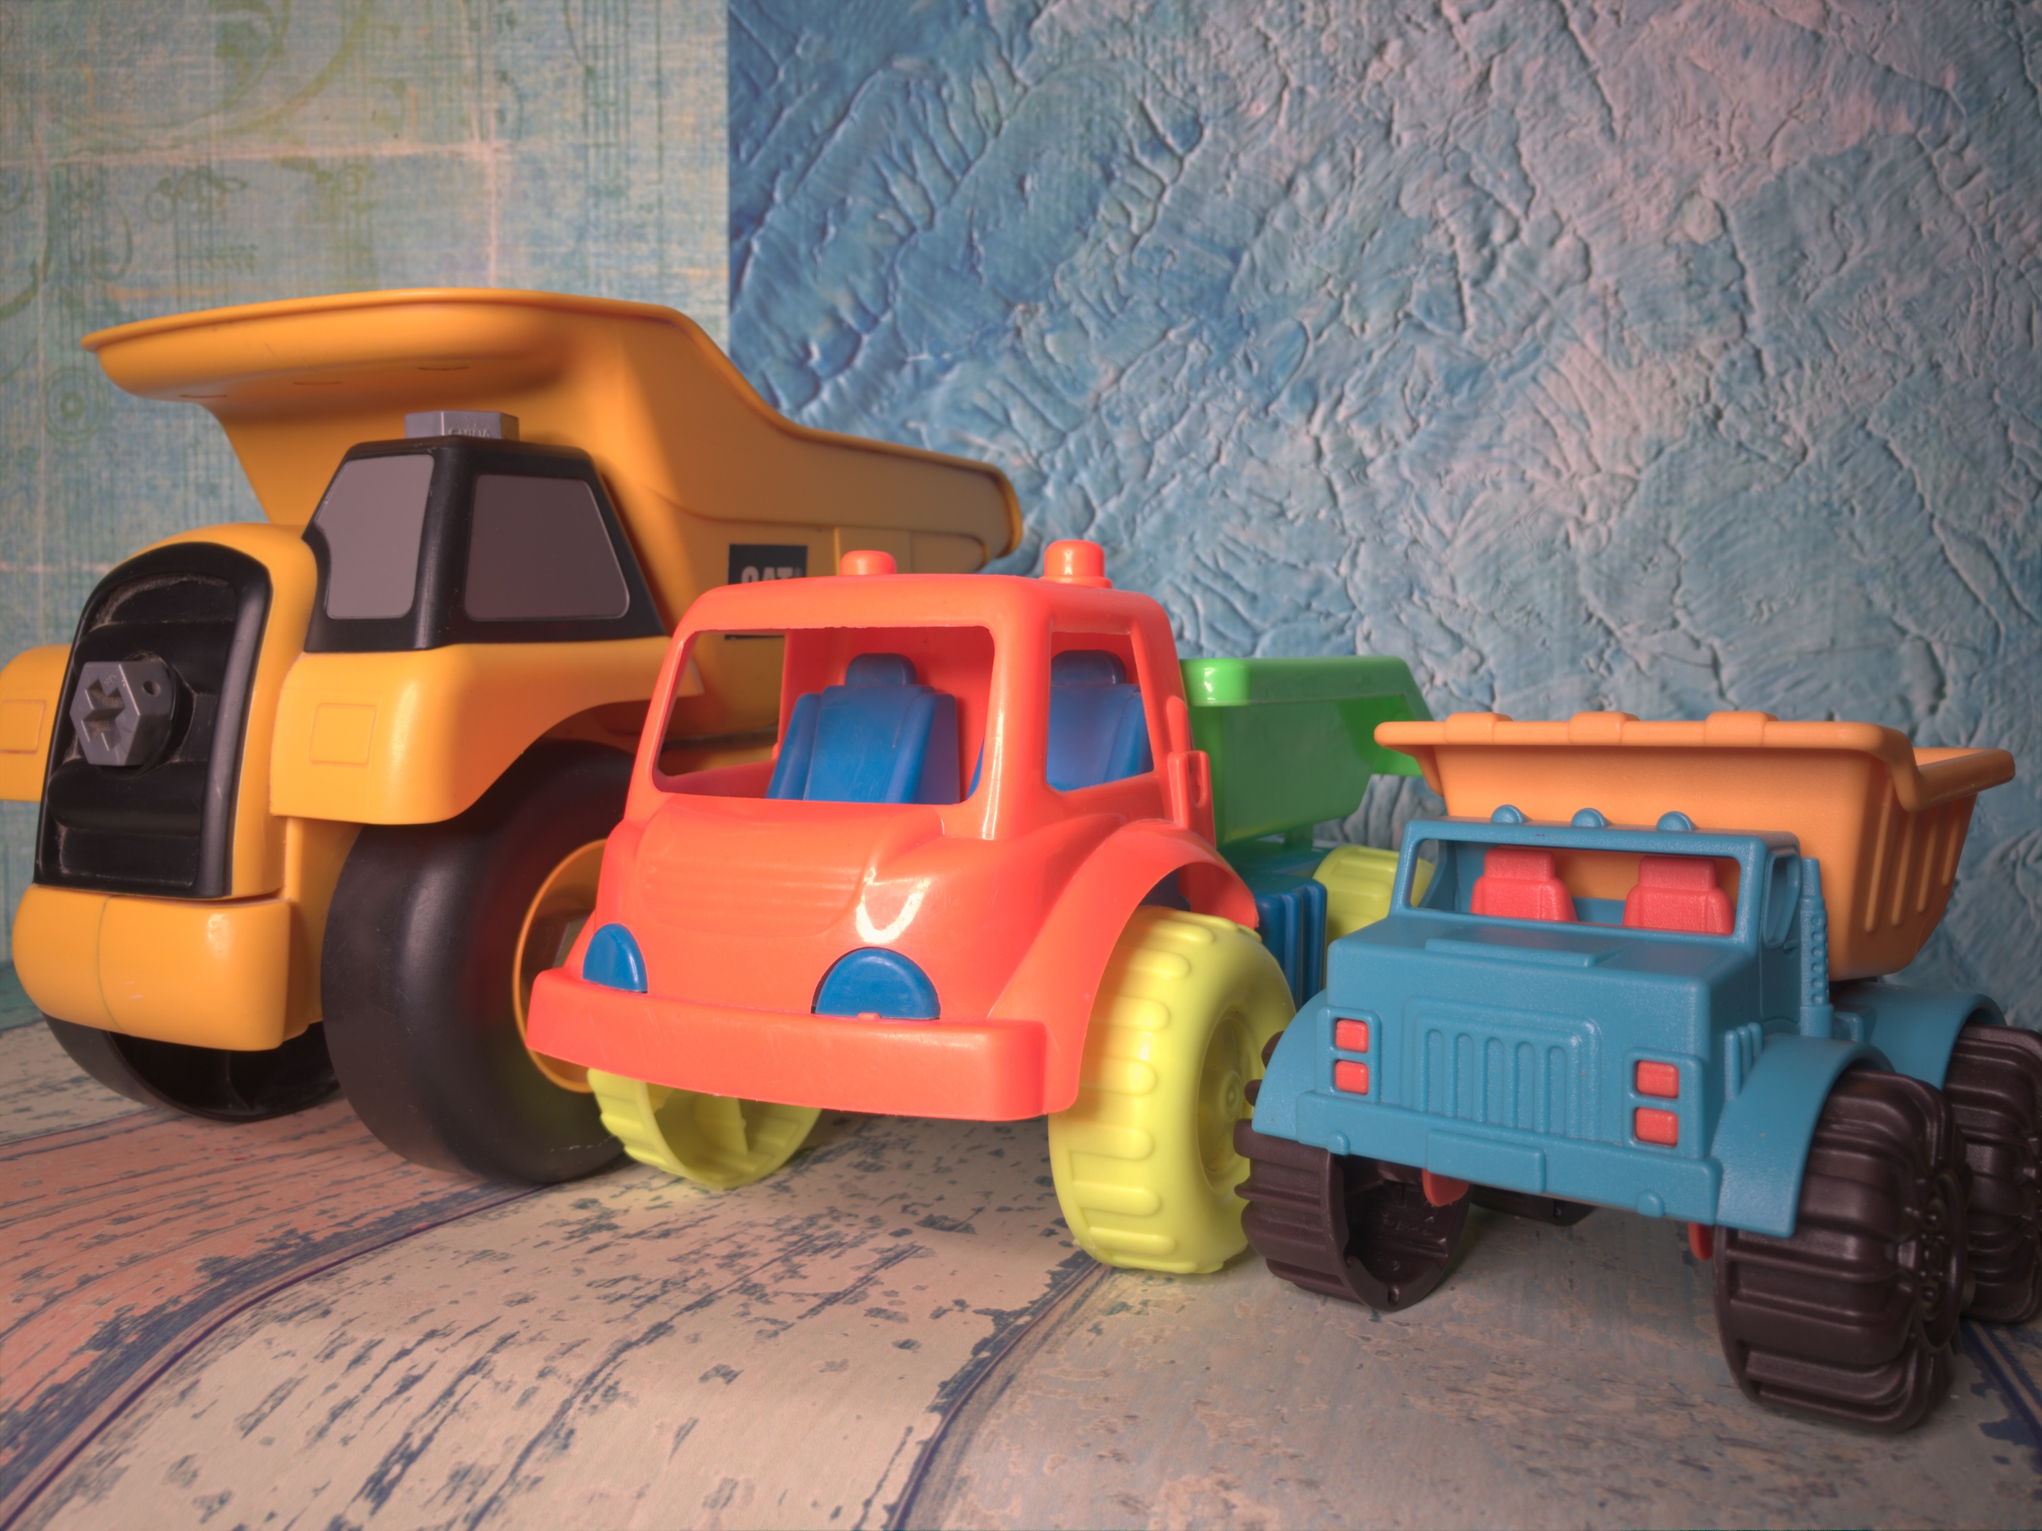

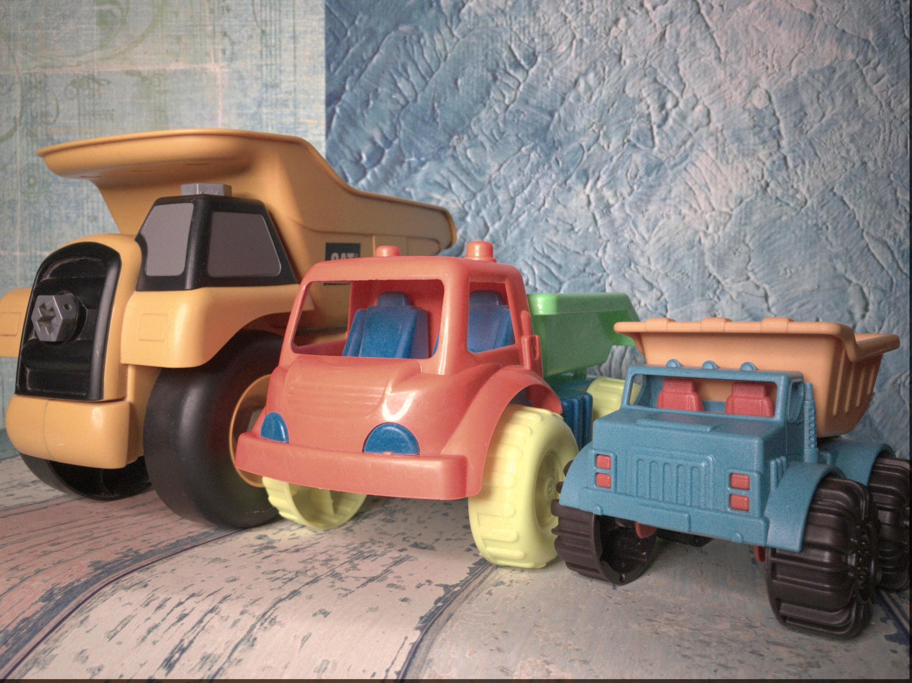
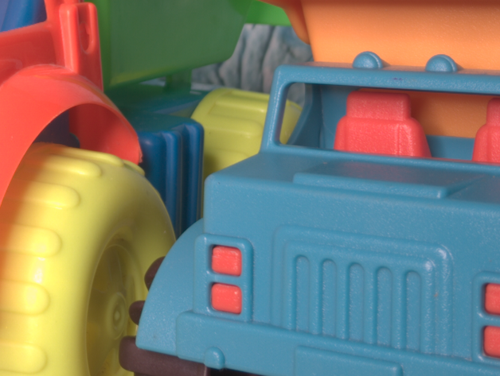
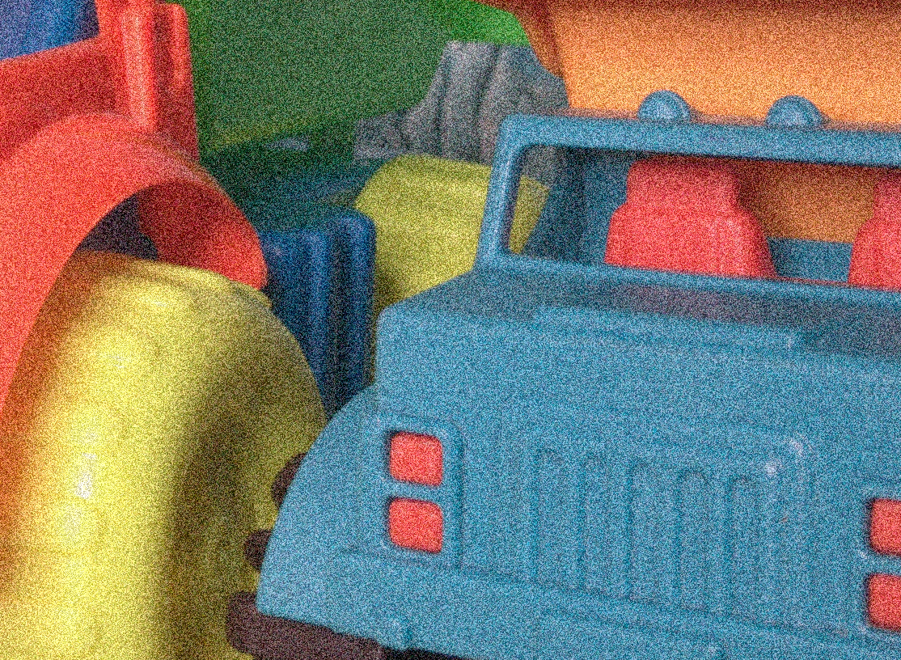
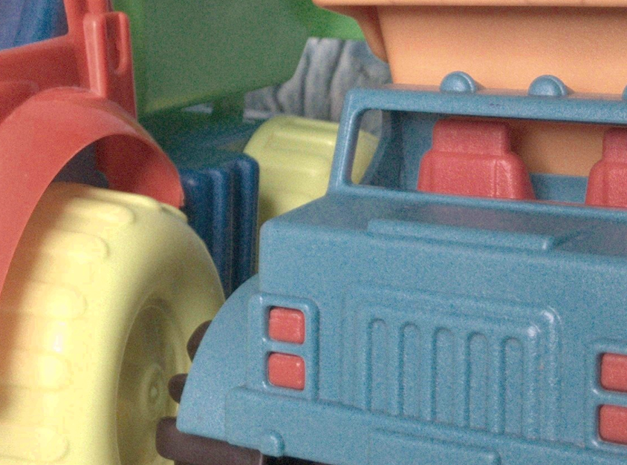
Denoised by Wavelet :
True
Noisy
Denoised

Slide 14
Interpretation:
Less competitive in time efficiency compared to Gaussian RBF kernel.
KPCA with Gaussian RBF kernel: 3 minutes per image denoising.
KPCA with Morlet wavelet kernel: 8 minutes per image denoising on average.
Other techniques, except CGNet and CBDNet, denoise under 2 minutes.
Future optimization aims to reduce Morlet kernel's time complexity.
KPCA with Morlet kernel achieves superior denoising over traditional filters.
Despite complexity, Morlet kernel outperforms PCA and KPCA with RBF.
Work is uploaded on Github .

Slide 15
Future Scope
Due to multiplicative nature of the Morlet Wavelet Kernel , we had some issues in implementation, which could be an area of improvement.
Algorithms like CGNet and CBDNet utilize different pre-processing and implementation techniques alongside kernels to get their results. Implementing those techniques together with the Morlet Kernel may give better results and create a new state of the art method altogether as for base case implementation the Morlet Kernel outperforms other kernels.

Slide 16
Thank You

